Slide 1


BCDAYES

Slide 2

Agentes al Rescate
Extendiendo la Integración Business Central–Dataverse con GitHub Copilot
BCDAYES

Slide 3















Nuestros Patrocinadores
PREMIUM
ESSENTIAL
BCDAYES

Slide 4

Session Agenda
Who is Fer? 👨‍💻
A HYPE World!🔥
The age of frameworks 🛠️
Show Time! 🎪
Takeaways 🍱
BCDAYES

Slide 5
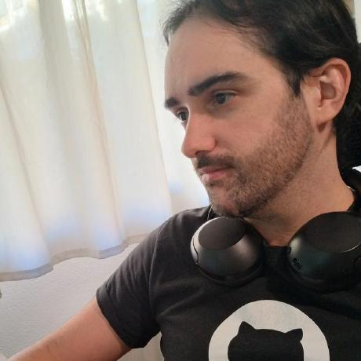




Fernando Artigas
Business Central Technical Consultant with strong expertise in AL & Power platform Integrations.
BCDAYES

Slide 6
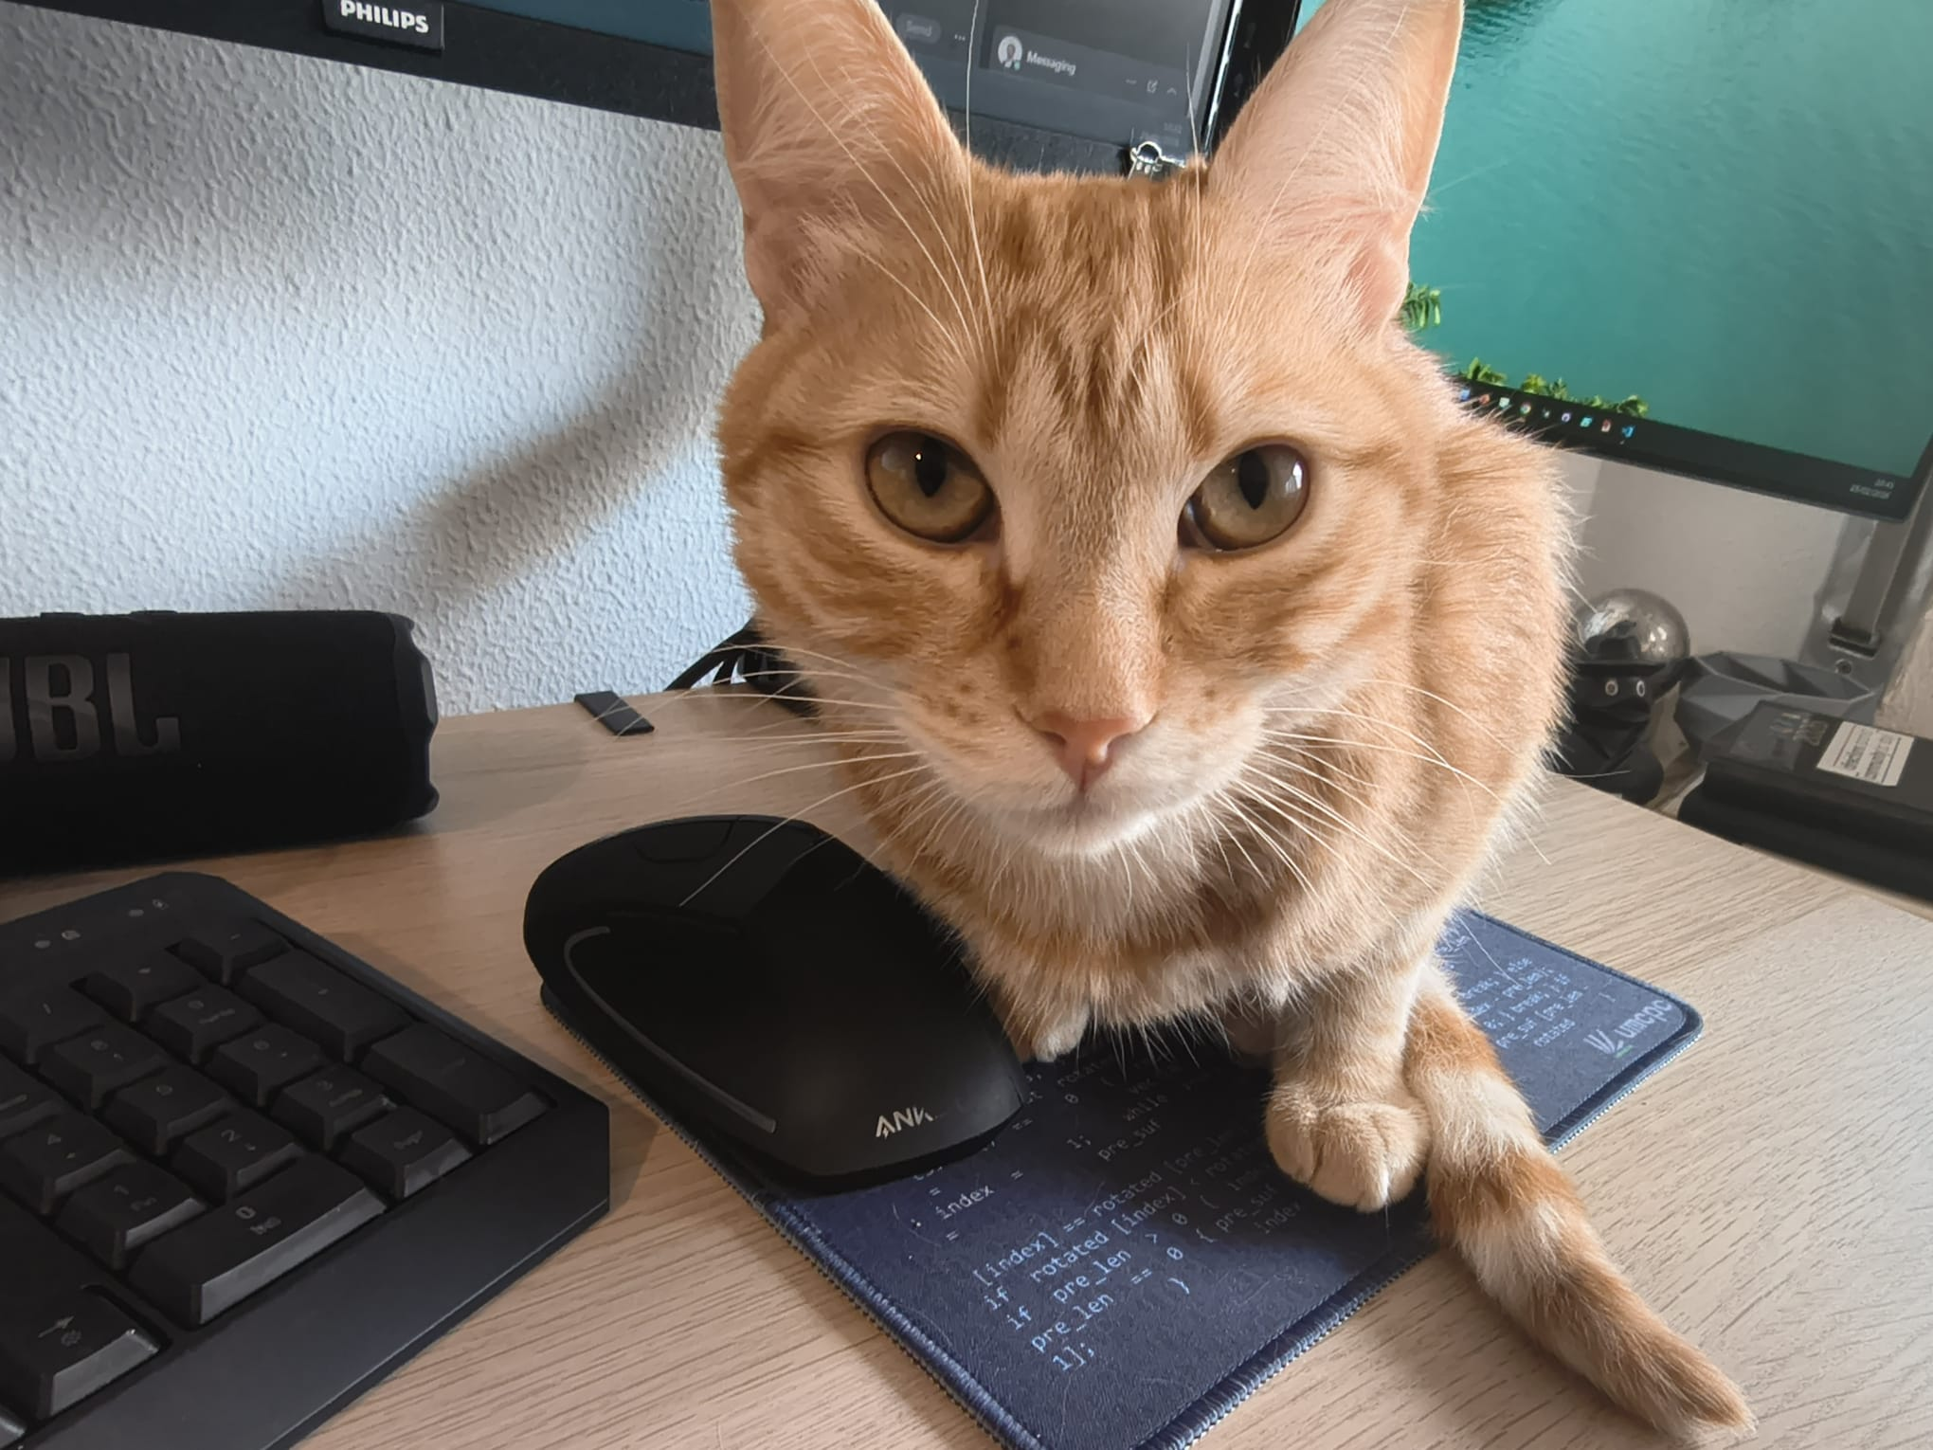

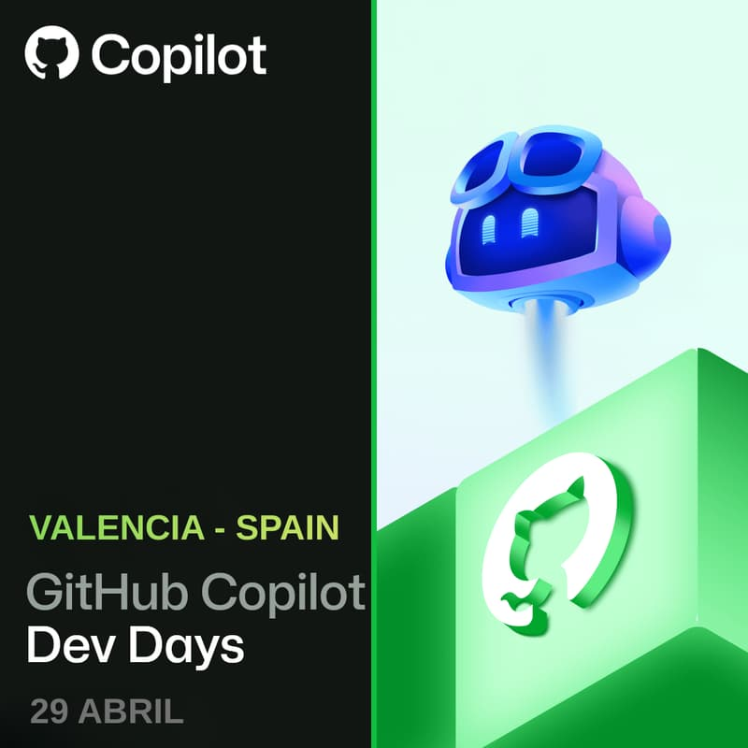

If you love to engage, we have more events for you!
BC Waves Barcelona 6 de junio de 2026
Non-profit day Spain
diciembre!
BCDAYES

Slide 7

Who is Fer and why is he here?
He loves the BC Community
(and hates AI Hype)
He has an interesting project to share with you (not just Dataverse Synch.)
He has a cool gift for you (not just stickers)
BCDAYES

Slide 8
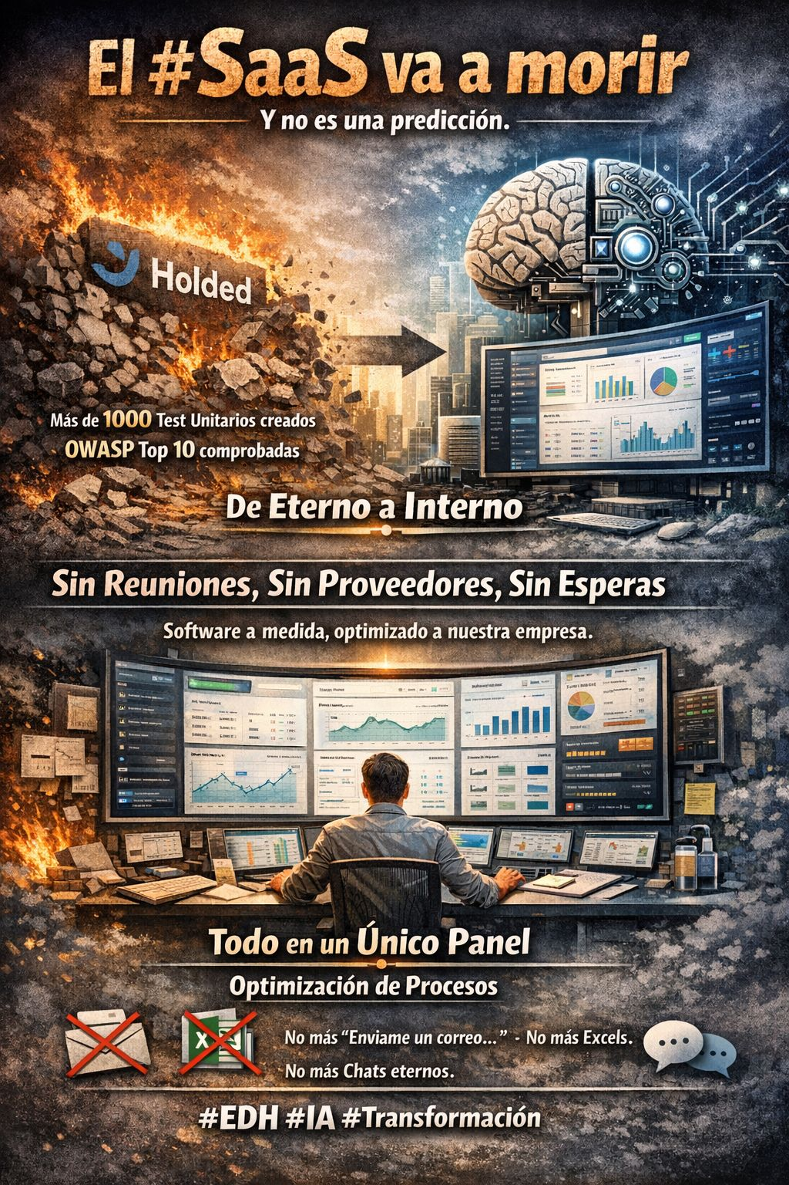
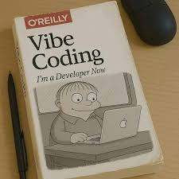
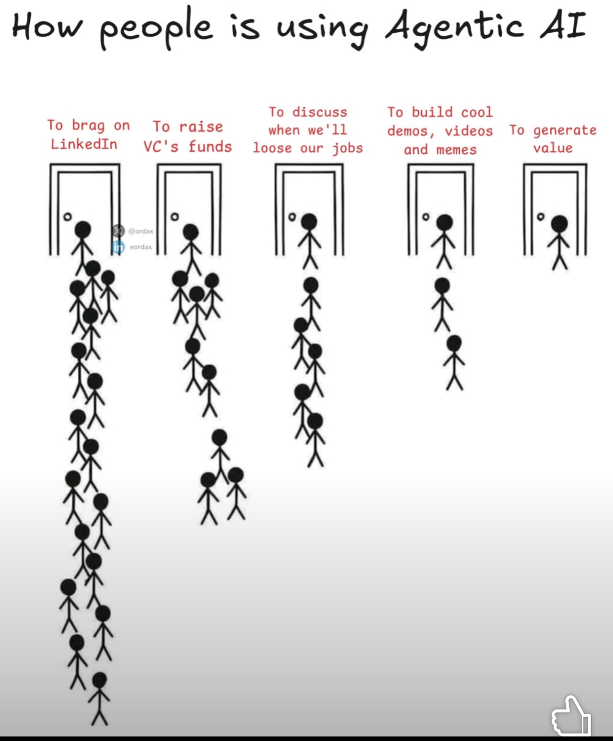
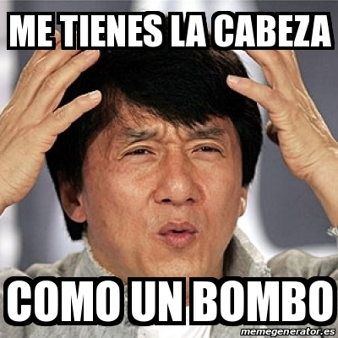
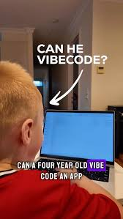

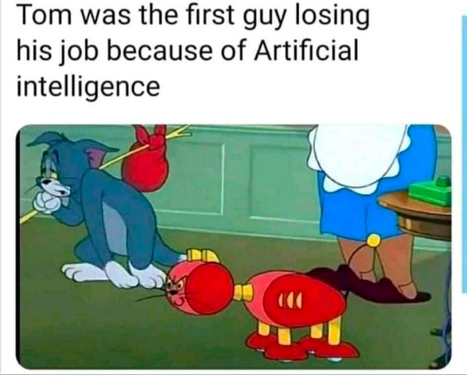
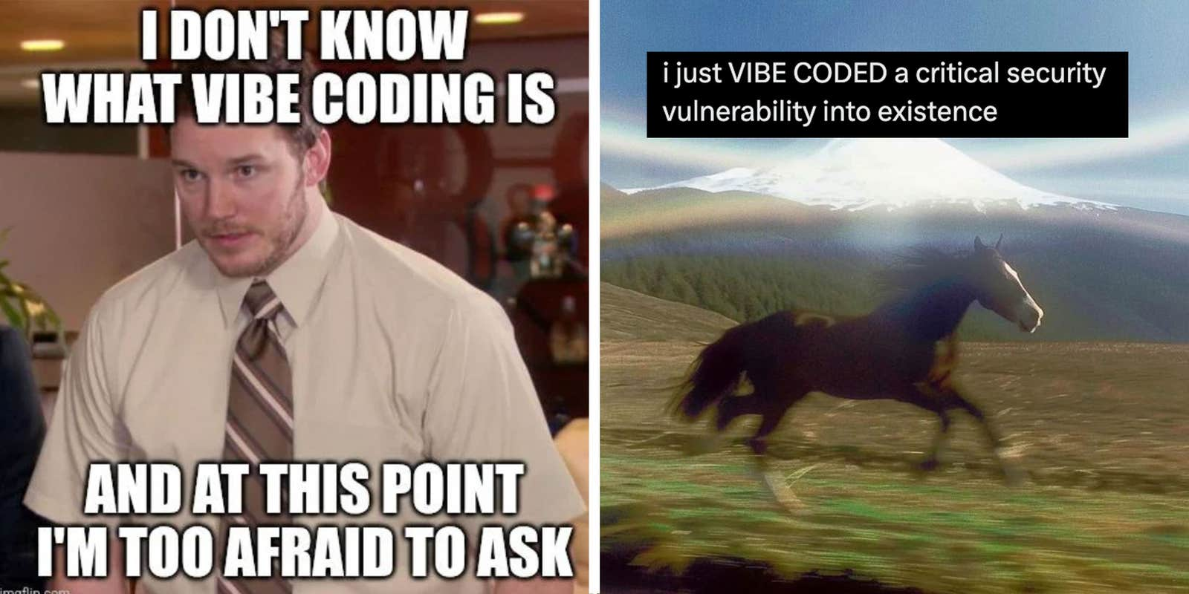
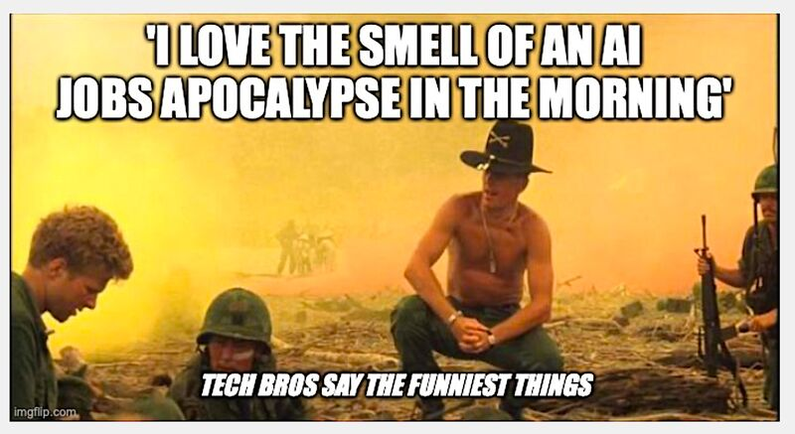
A HYPE World!🔥
5 4 3 2 1
BCDAYES

Slide 9
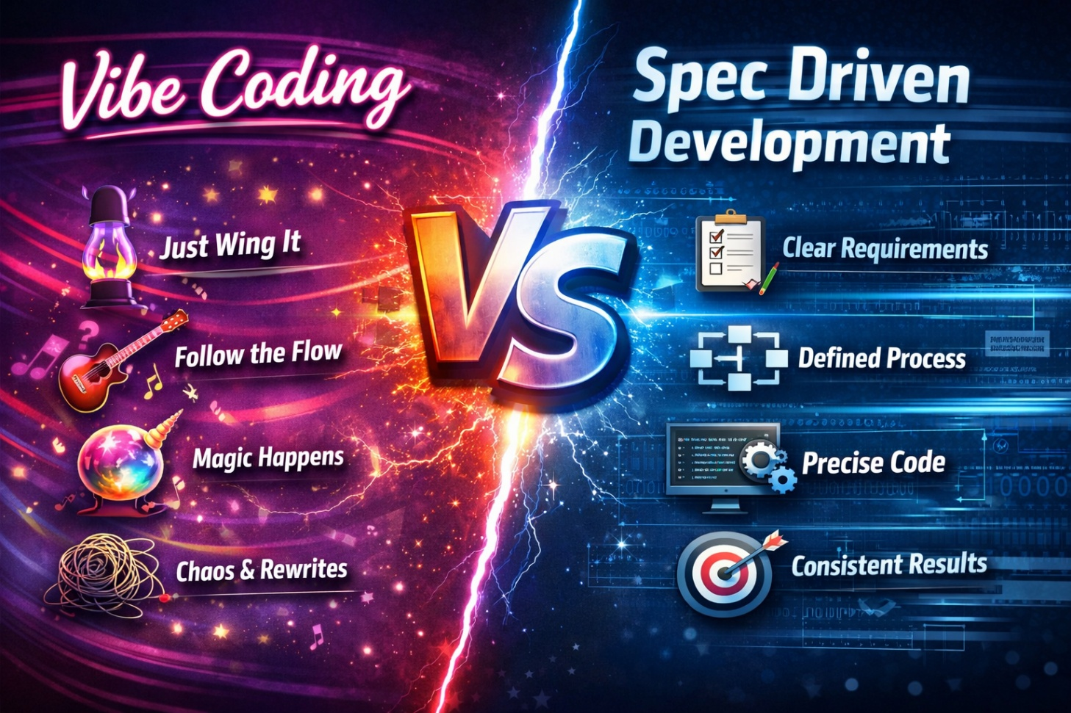
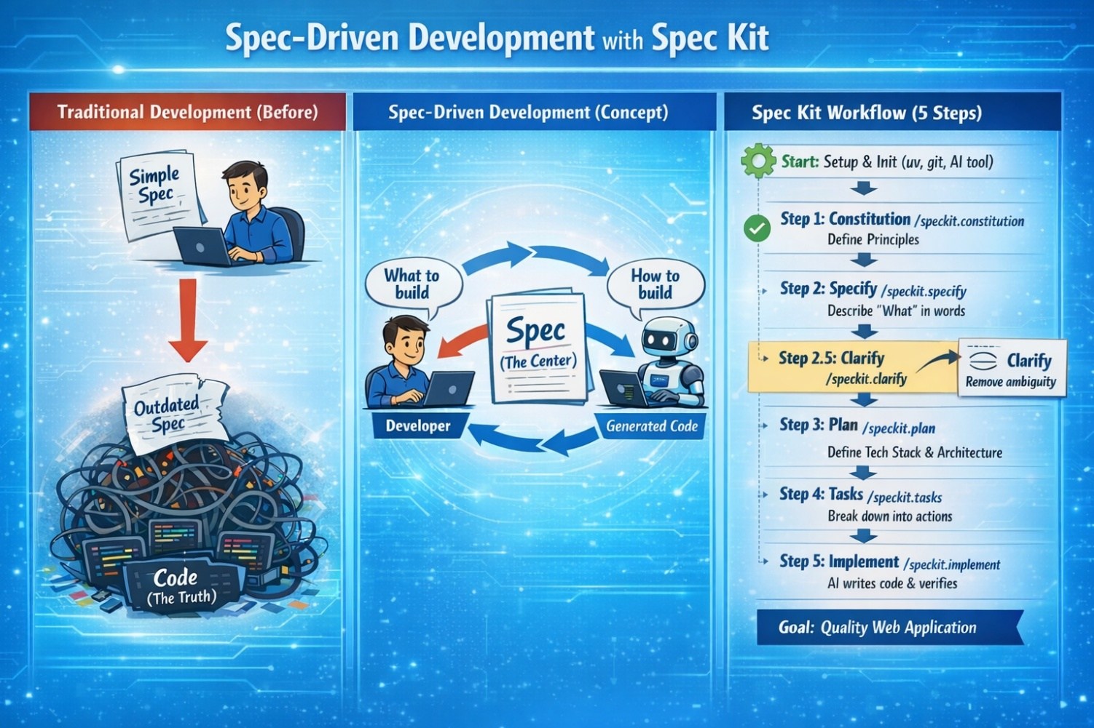
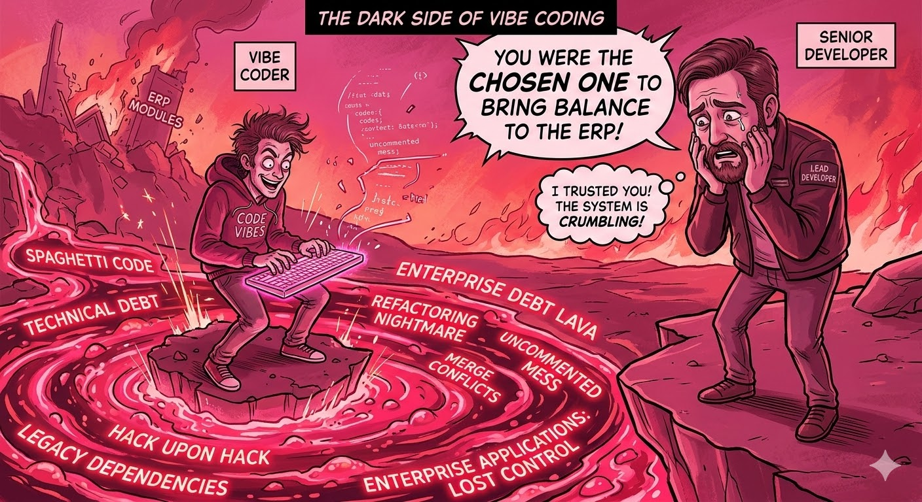
Vibe Coding VS Spec Driven Development🛠️
BCDAYES

Slide 10

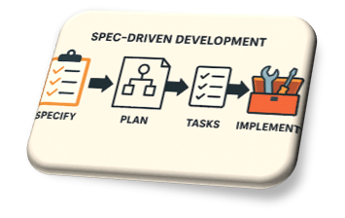






The age of frameworks 🛠️
BCDAYES

Slide 11


BCDAYES

Slide 12







This is not a vibe coding cult…this is a framework
This is not a private library…this is an Open-Source Project
This is not Fer’s next blog format…It is community driven!
This is not hype…this will save us time!
BCDAYES

Slide 13

Showtime! Talk is cheap show me the skills!
BCDAYES

Slide 14
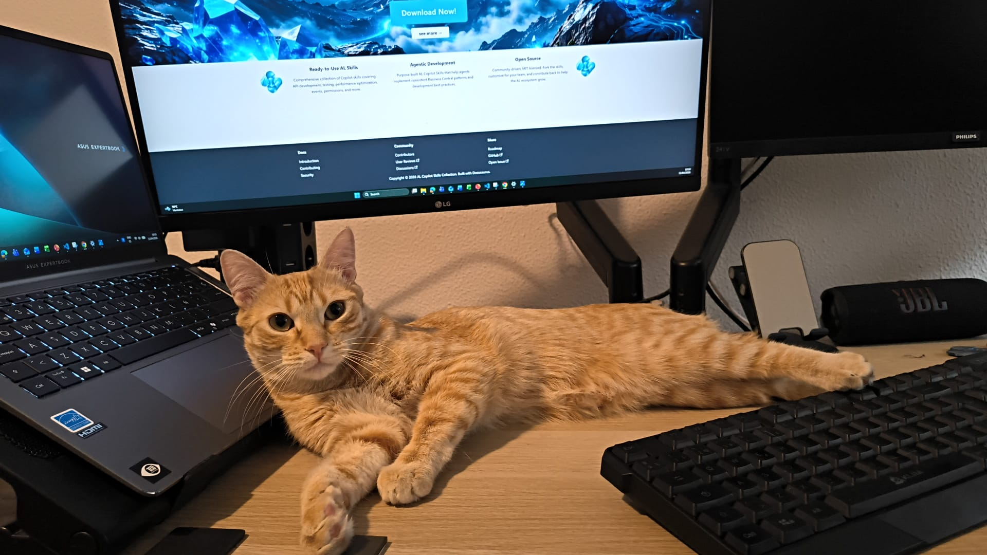
Takeaways 🍱
You already have the skills!
Share it with your workmates and that will help the company
Share it with the community and you will the hero that gave them time to focus on what matters the most!
BCDAYES

Slide 15
GRACIAS
BCDAYES

Slide 16
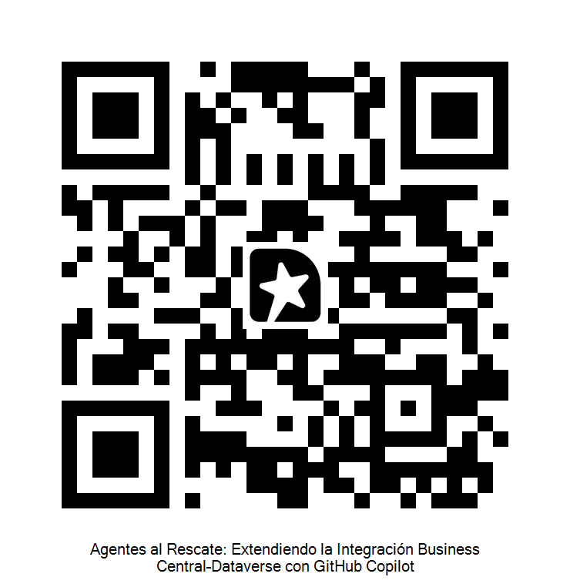
Rate this session
BCDAYES

